Slide 1

Document Object Model (DOM)

Slide 2

What you need to understand first

Slide 3
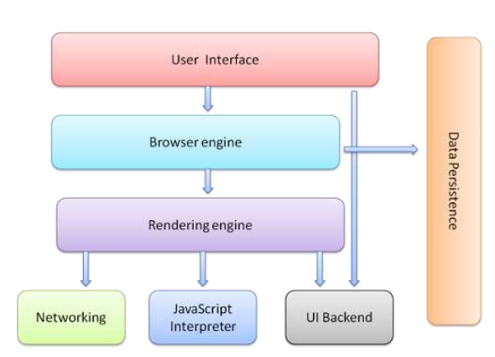
Web Browser Architecture

Slide 4
The User Interface
Provides the methods with which a user can interact with the Browser Engine.
This includes the address bar, back/forward button, bookmarking menu, etc.
Every part of the browser interface except the window where you see the requested page

Slide 5
The Browser Engine
It organizes actions between the UI and the rendering engine.
This provides a high-level interface to the Rendering Engine.
The Browser Engine provides
methods to initiate the loading of a URL
high-level browsing actions (reload, back, forward).
it also provides the User interface with various messages relating to error messages and loading progress.

Slide 6
The Rendering Engine:
It produces a visual representation for a given URI
It is capable of displaying HTML and Extensible Markup Language (XML) documents, optionally styled with CSS, as well as embedded content such as images
It calculates the exact page layout and may use “reflow” algorithms to incrementally adjust the position of elements on the page
This subsystem also includes the HTML parser

Slide 7
Rendering Engine: Example
Different browsers use different renedering engines
Blink – Used in Google Chrome, and Opera browsers.
WebKit – Used in Safari browsers.
Gecko – Used in Mozilla Firefox browsers.
Trident – Used in Internet Explorer browsers.
EdgeHTML – Used in Edge browsers.
Presto – Legacy rendering engine for Opera.

Slide 8
The Networking
The Networking subsystem implements file transfer protocols such as HTTP and FTP
It translates between different character sets, and resolves MIME media types for files
It may implement a cache of recently retrieved resources

Slide 9
The JavaScript Interpreter
This component executes the JavaScript code that is embedded in a website.
Results of the execution are passed to the Rendering Engine for display.
The Rendering Engine may disable various actions based on user defined properties.

Slide 10
The UI Backend:
Used for drawing basic widgets like combo boxes and windows
Underneath it uses operating system user interface methods.

Slide 11
The Data Storage
Manages user data such as bookmarks, cookies and preferences.
The new HTML specification (HTML5) defines 'web database' which is a complete (although light) database in the browser.

Slide 12
It is important to note that browsers such as
Chrome run multiple instances of the rendering engine: one for each tab. Each tab runs in a separate process.
https://www.html5rocks.com/en/tutorials/internals/howbrowserswork

Slide 13
Document Object Model
The DOM is an object-oriented representation of the web page, which can be modified with a scripting language such as JavaScript.

Slide 14
Javascript and the DOM
Originally, the Document Object Model (DOM) and JavaScript were tightly bound
Each major browser line (IE and Netscape) had their own overlapping DOM implementation
Now, the DOM is a separate standard, and can be manipulated by other languages (e.g. python etc.)
Browsers still differ in what parts of the standard they support, but things are much better now

Slide 15
Document Object Model
Core DOM - standard model for all document types
XML DOM - standard model for XML documents
HTML DOM - standard model for HTML documents
Notes:
Document Object Model

Slide 16
Document Object Model
When a web page is loaded, the Rendering Engine in the browser creates a Document Object Model tree of the page.
The HTML DOM model is constructed as a tree of Objects:
The HTML elements as objects
The properties of all HTML elements
The methods to access all HTML elements
The events for all HTML elements
*How to get, add, change or delete HTML element

Slide 17
Document Object Model
With the object model, JavaScript gets all the power it needs to create dynamic HTML:
JavaScript can change all the HTML elements in the page
JavaScript can change all the HTML attributes in the page
JavaScript can change all the CSS styles in the page
JavaScript can remove existing HTML elements and attributes
JavaScript can add new HTML elements and attributes
JavaScript can react to all existing HTML events in the page
JavaScript can create new HTML events in the page

Slide 18
Review: DOM Structure
Window → Browser window
* location → Current URL (e.g. google.com)
* frames → Contains HTML document
* history → Information about visited links (URLs)
* navigator → Information about Browser
* event → state of keyboard keys, mouse
* screen → Screen information (width, height)
* document
o links
o anchors
o images
o filters
o forms
o scripts
o selection
o stylesheets
o body
Objects are in a hierarchy
The window is the parent for a given web page
Document is the child with the objects that are most commonly manipulated
For further information
http://whatsock.com/jsr/htmldom

Slide 19
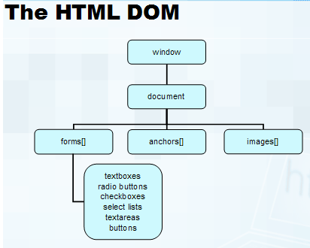
HTML DOM

Slide 20

DOM Tree
The usual parent/child relationship between node
Like any other tree, you can walk this

